Slide 1
PROJECT - 39
GROUP - 03

Slide 2
Trip Advisor Review Classification
BUSINESS OBJECTIVE –
Extract reviews from trip advisor for hotel of your choice and do check for positive, negative along with ratings. We have to classify reviews based on amenities of a hotel and identify key highlights.
Hotel – Marina Bay Sands Singapore

Slide 3
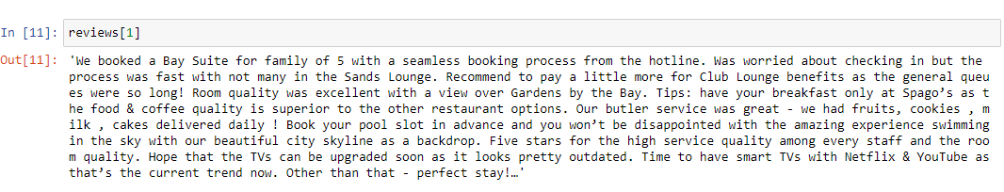
Web scraping
Review Example

Slide 4
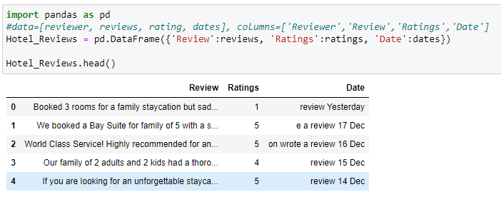

Slide 5
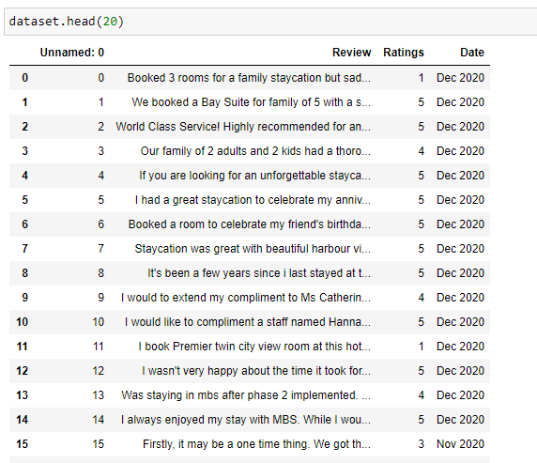
Cleaning Reviews

Slide 6
Exploratory Data Analysis

Slide 7
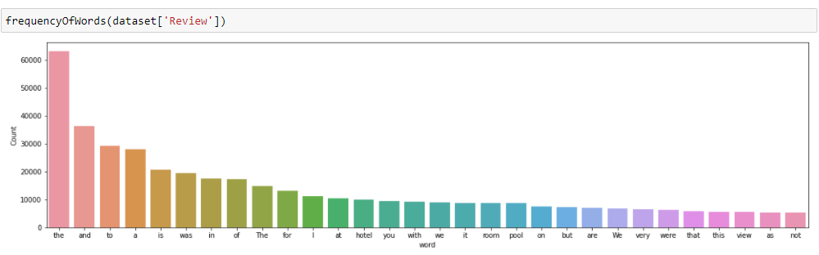
Frequency of words

Slide 8
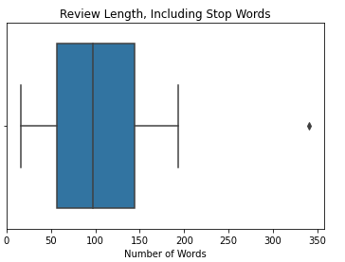
Boxplot (Review length including stop words)

Slide 9
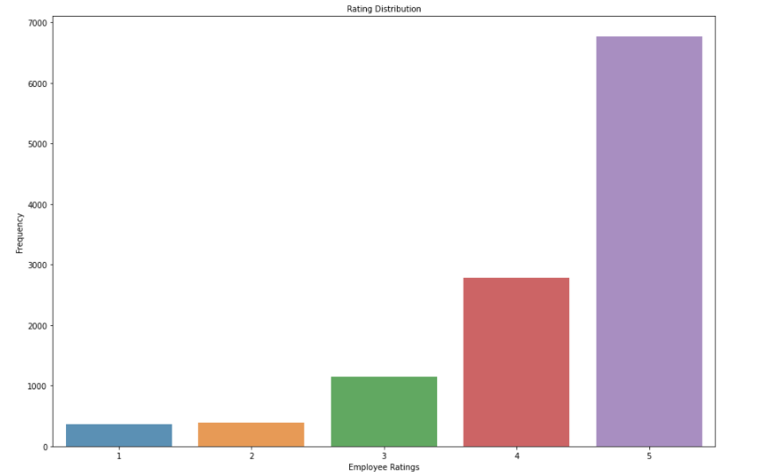
Rating Distribution

Slide 10
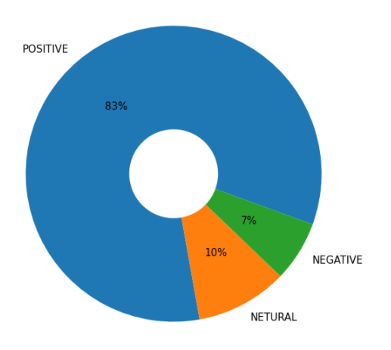
Percentage of ratings

Slide 11
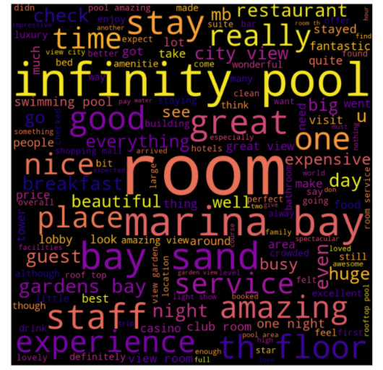
Word Cloud

Slide 12
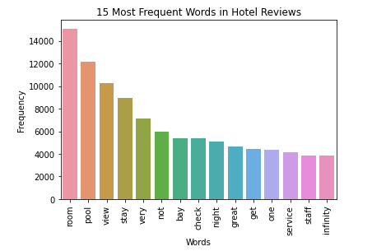
15 Most frequent words in hotel reviews

Slide 13
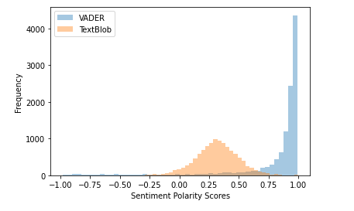
Distribution plot

Slide 14
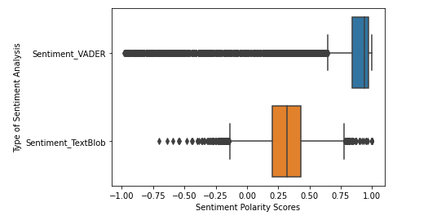
Boxplot

Slide 15
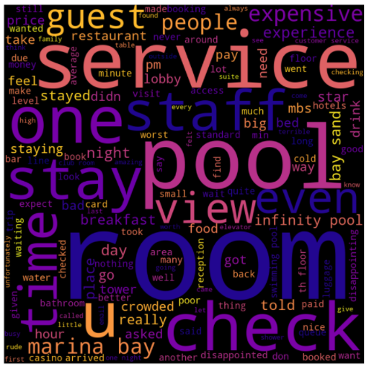
Word Cloud (Positive Reviews)

Slide 16
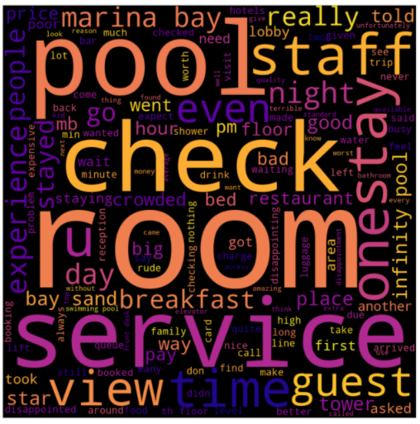
Word Cloud (Negative Reviews)

Slide 17
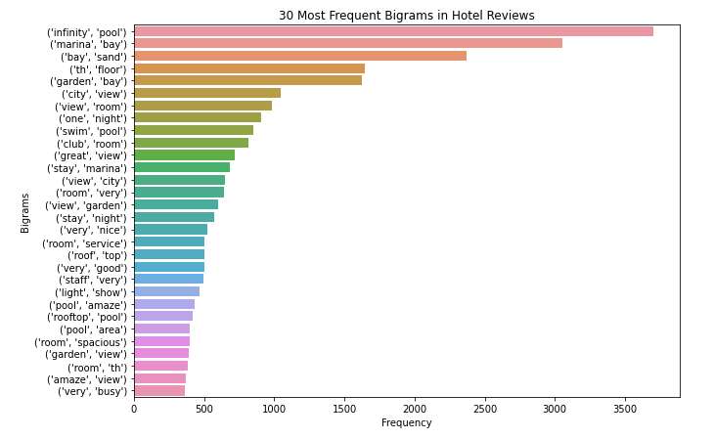
30 Most Frequent Bigrams in Hotel Reviews

Slide 18
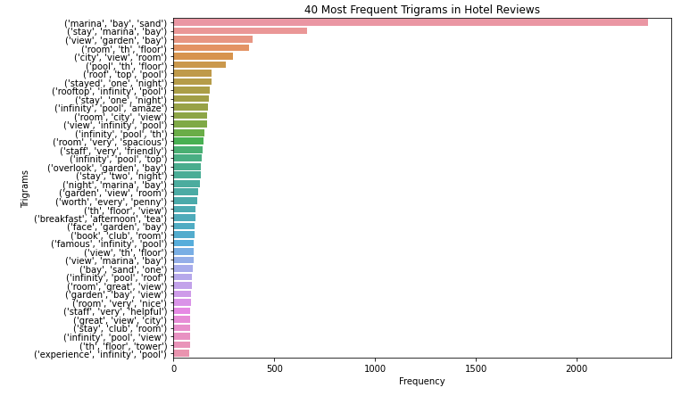
40 Most Frequent Trigrams in Hotel Reviews

Slide 19
Reviews after final processing
Title | No. of Reviews
Total | 11450
Positive | 9545
Negative | 1149
Neutral | 759

Slide 20
Model Building

Slide 21
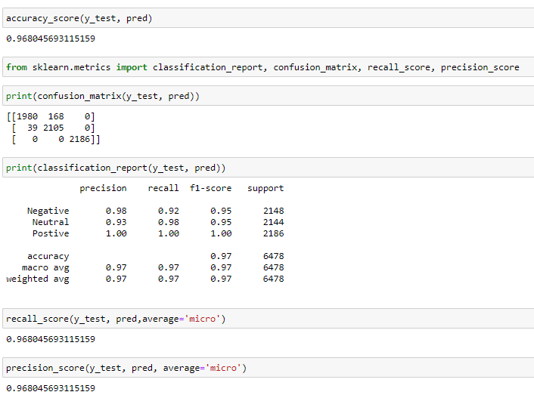
Random Forest Classifier

Slide 22
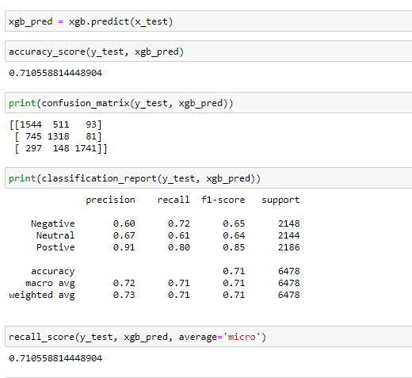
XGBoost

Slide 23
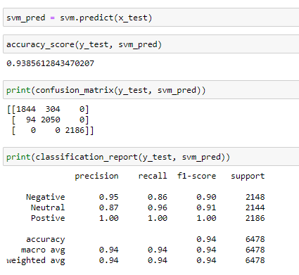
Support Vector Machine

Slide 24
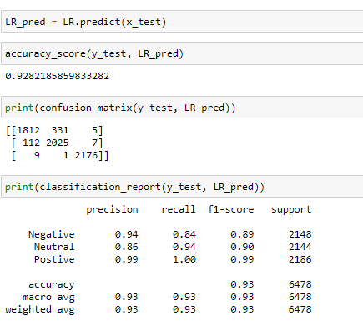
Logistic Regression

Slide 25
Final Model
Random Forest Classifier

Slide 26


Slide 27
Deployment

Slide 28
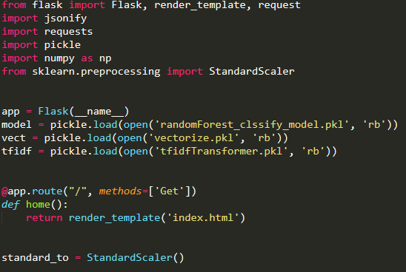

Slide 29
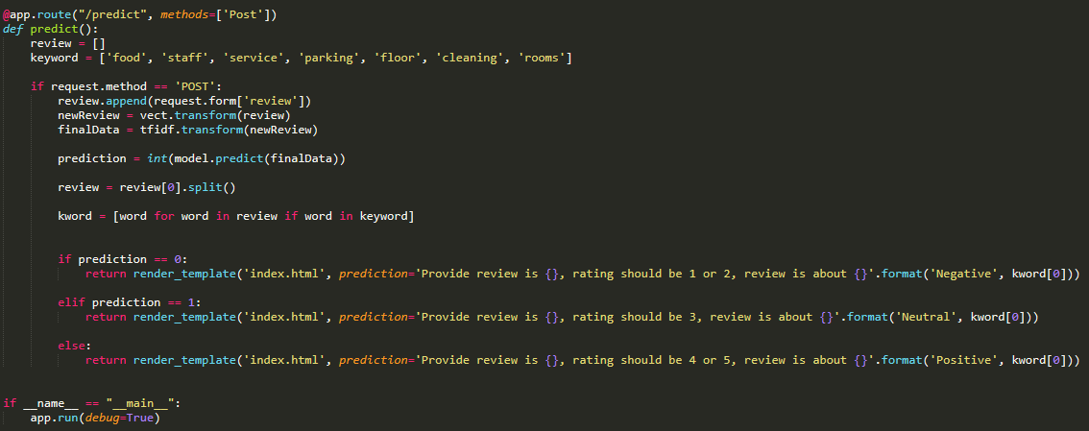

Slide 30
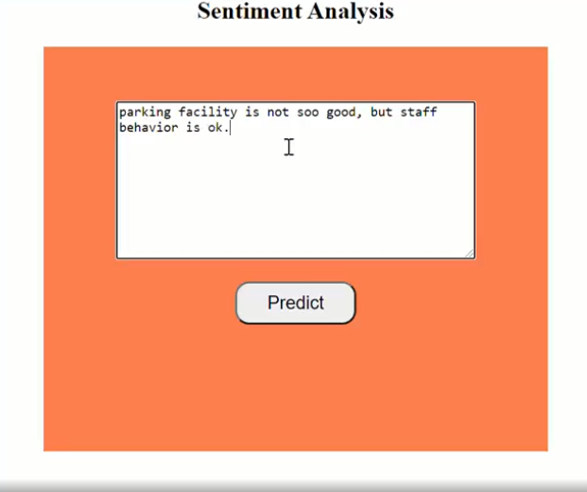

Slide 31
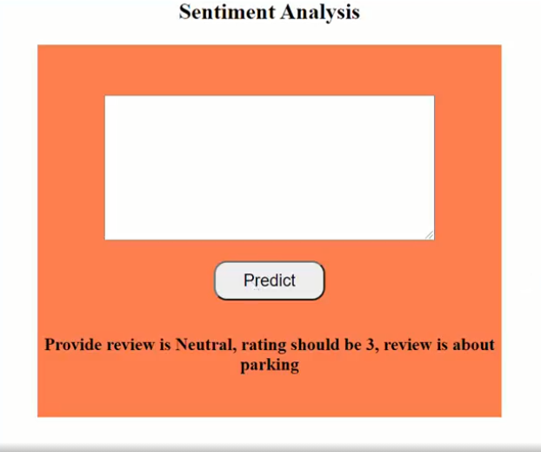

Slide 32
THANK YOU
HARISH SONI
PRAJWAL DHUMAL
SARFARAZ ANSARI
CHANDAN N.
MOHAMMED UMAR FAROOQ
SAINATH DAHIBHATE

